Slide 1

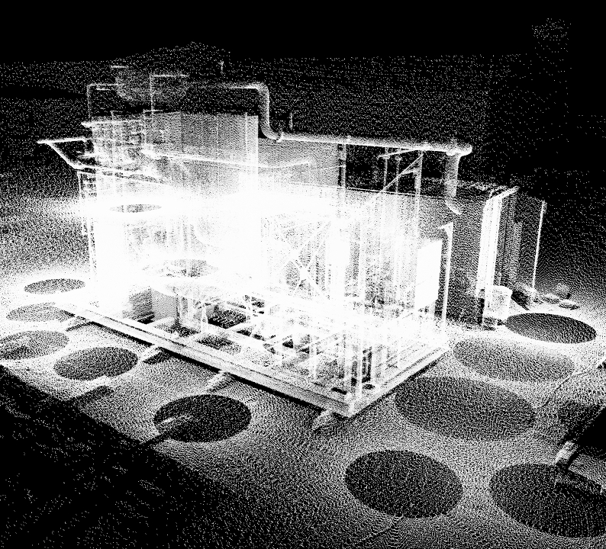
Point Clouds Processing Tutorial
Beginner level Introduction & Building a point clouds classification model
Presenter: Zhoukatong Xia
Notes:
Pic ref: https://www.kohera3d.com/point-cloud-meshing/

Slide 2
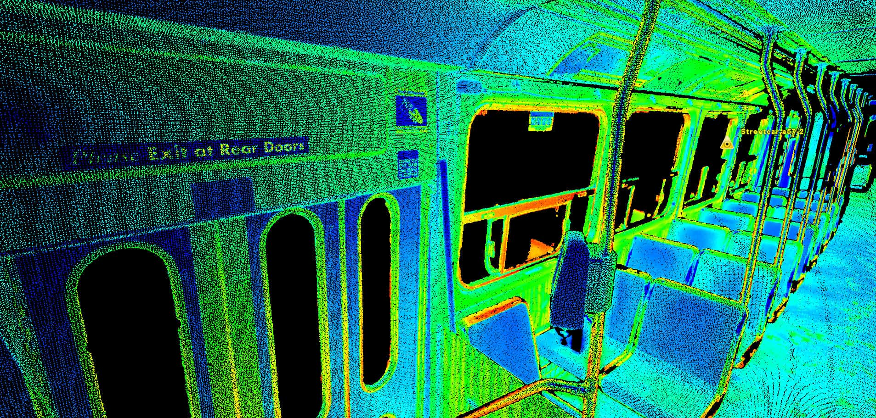
What is Point Clouds?
In recent years, there is a “new” way to sense the world, detect our familiar surrounding but gives an unfamiliar result -- the Point Clouds
Even though, Point Clouds and 3d sensors(like Lidar), has existed for decades, many people start to know it recently.
So what makes point cloud so popular? We should have a deeper look at our smart phones, cars and VR/AR devices.
Ref: Point Cloud Conversion to 3D Model [1]
Source: https://www.cadcam.org/3d-scanning/converting-point-clouds-into-cad/

Slide 3
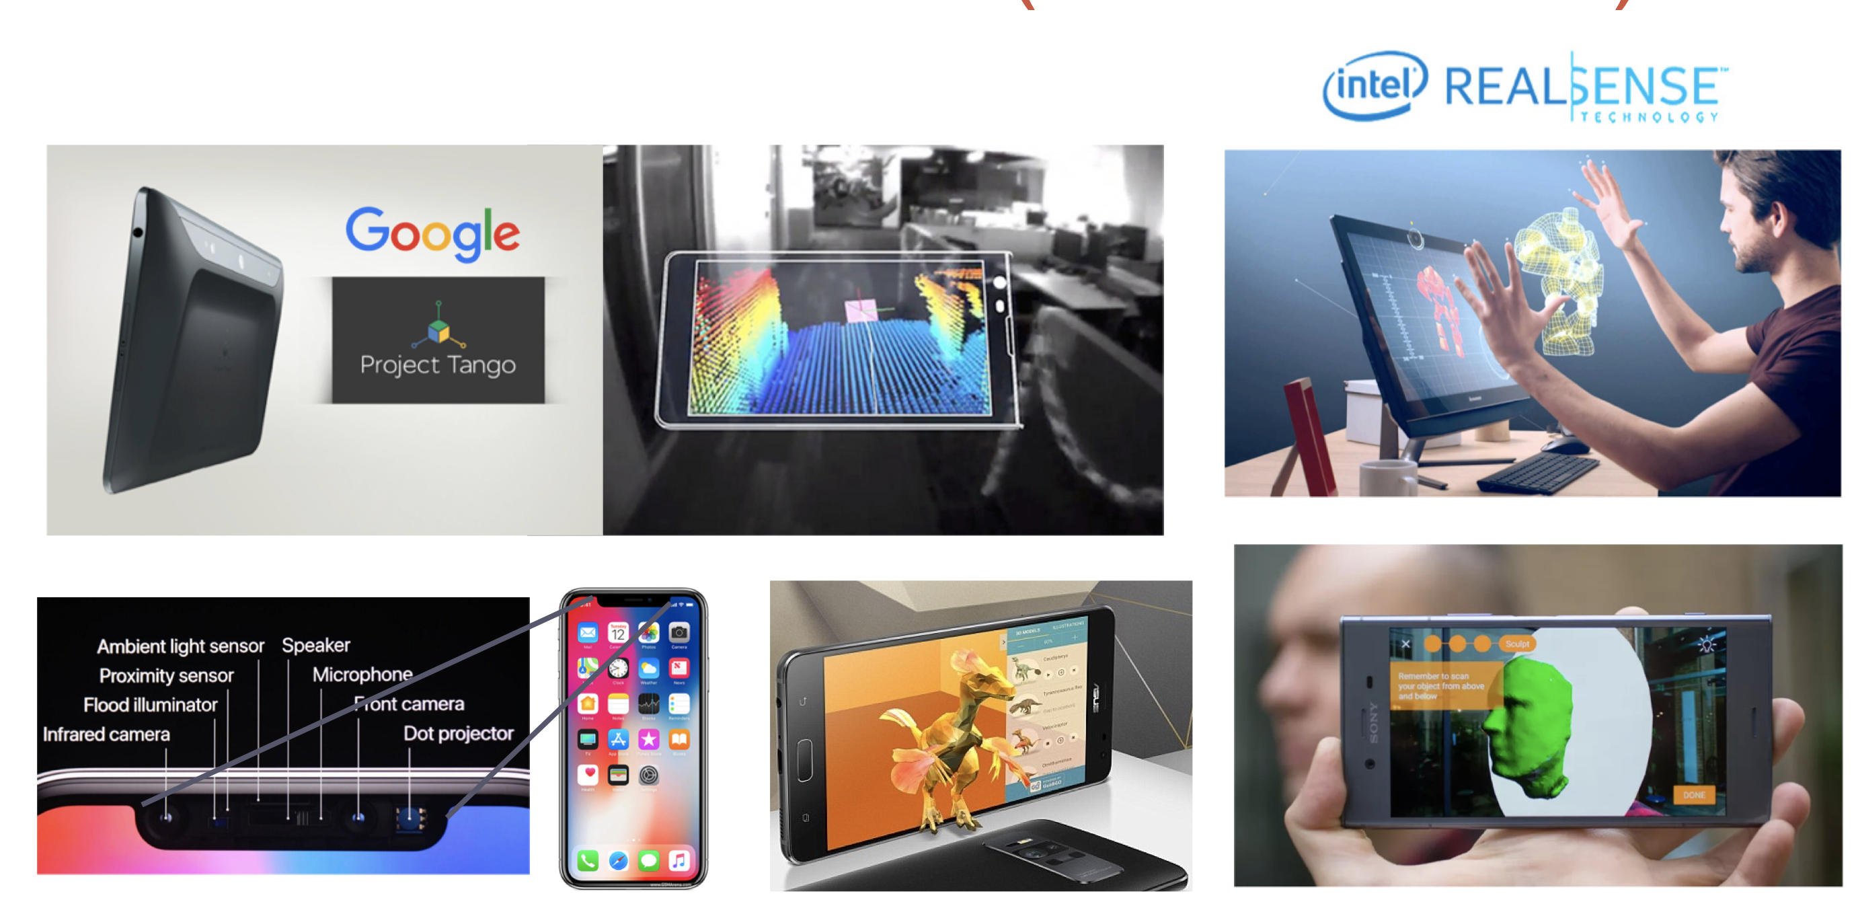
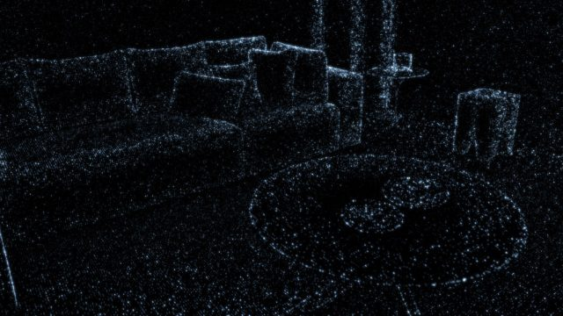
More and more smart phone can capture Point Clouds (like Iphone11/12, Asus Zenfone AR, Sony Xperia XZ1…)
Sensor
Point Clouds vs. Smart Phone
And many applications are based on point clouds data, like:
Apple Face ID use a dot projector to gather around 3000 points to identify user’s face.
Newly released Iphone12 Pro owns currently(2020) the best Lidar scanner, which could build 3d model for your room, detect obstacle for people with visual impairment, and do auto-focus and subject detection at night.
However, all device has a limiting scanning range(1m-5m), Sometimes, we want to see the world, not just my room.
Devices that can capture Point Clouds
Ref: Deep Learning on Point clouds: Implementing PointNet in Google Colab [1]
[3] Source: https://www.roadtovr.com/apple-iphone-12-pro-max-lidar-instant-ar-depth-mapping/

Slide 4
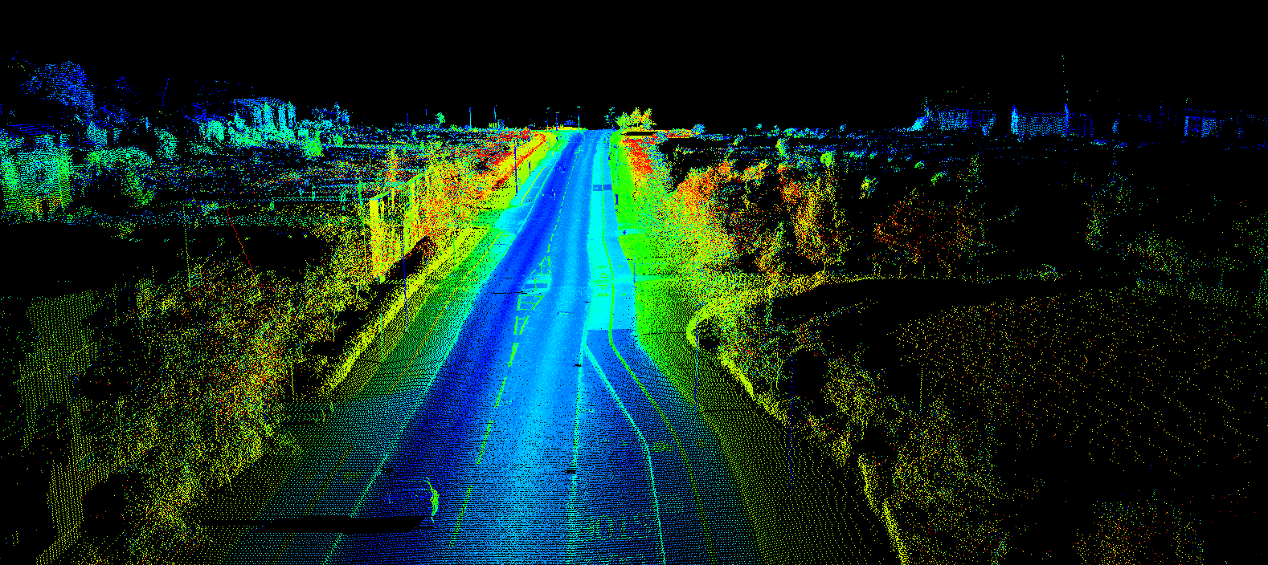
Here is the world in point clouds format.
We can imagine a vehicle with Lidar was traveling forward and generate this 3d model.
But to do so, better 3d scanner with longer range and better resolution is needed.
[4] Ref: https://techcrunch.com/2017/02/12/wtf-is-lidar/

Slide 5
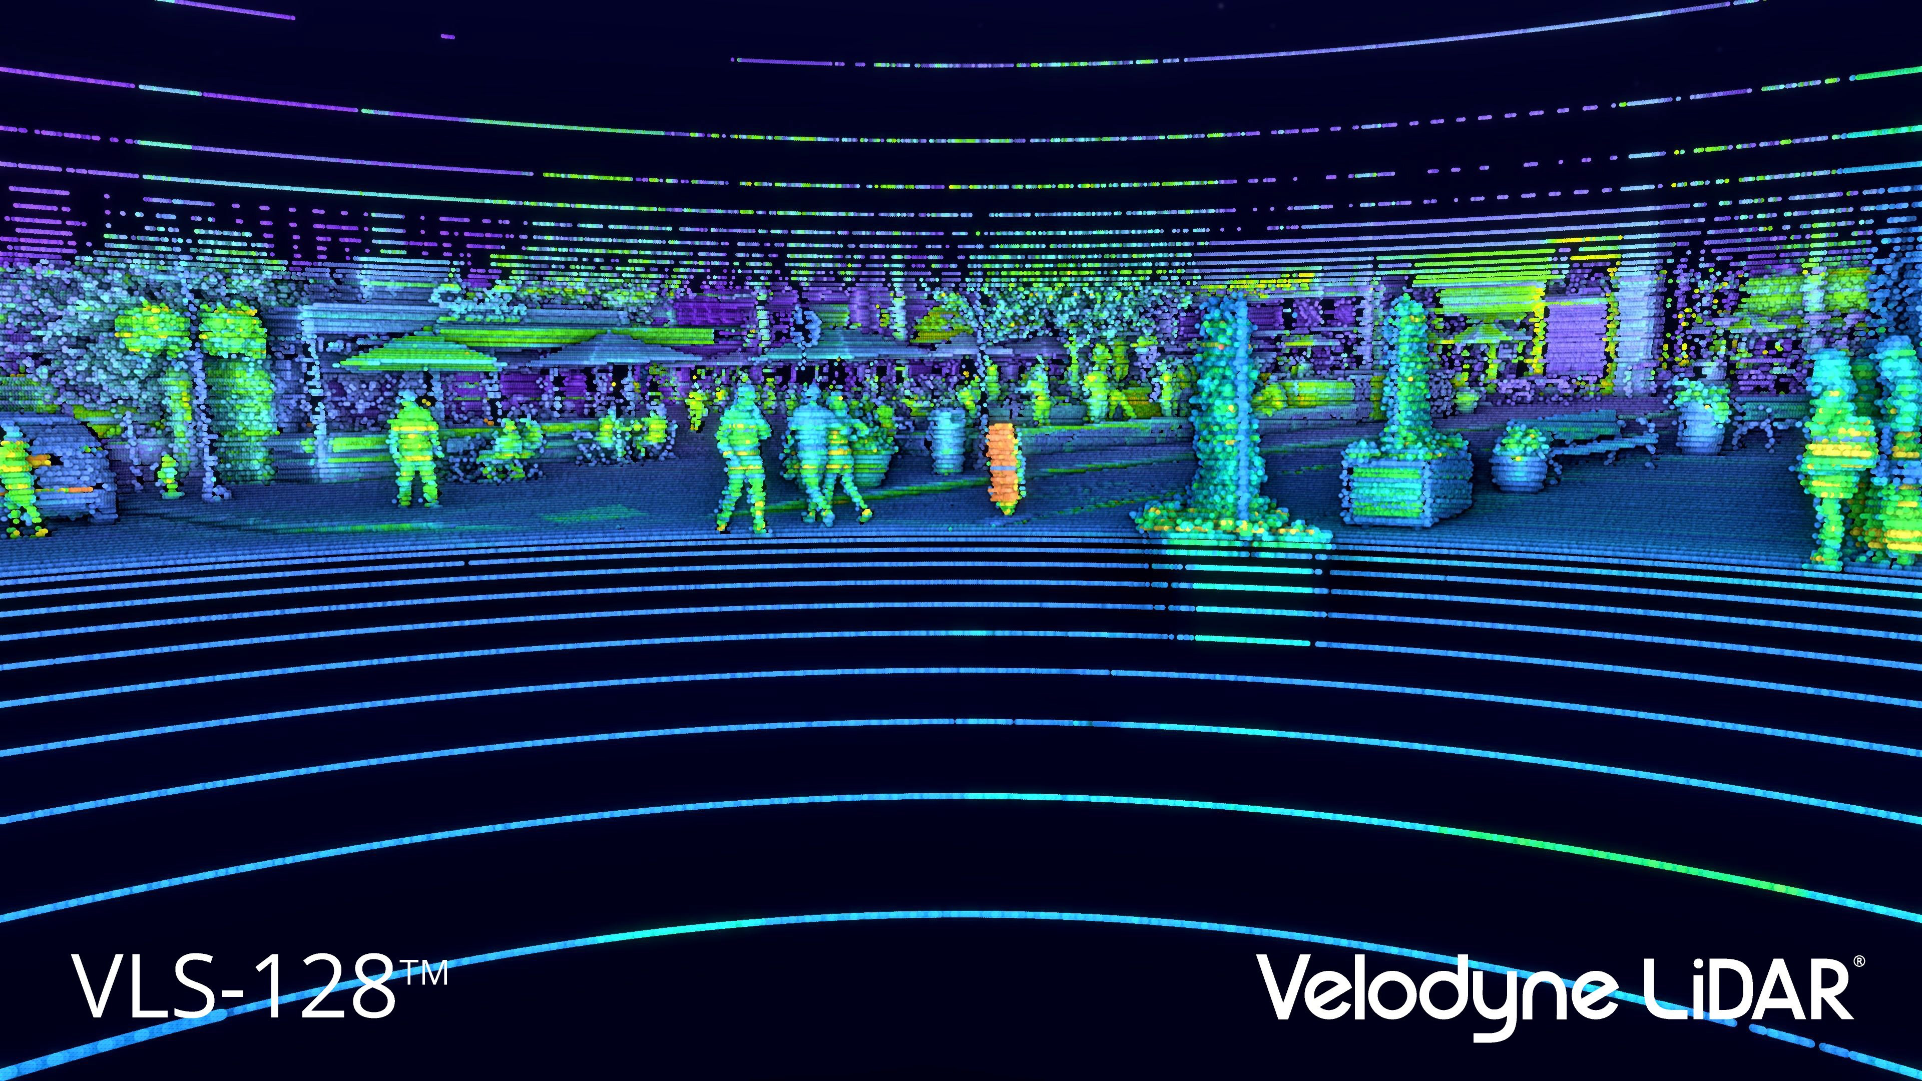
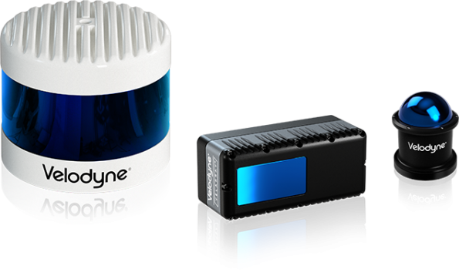
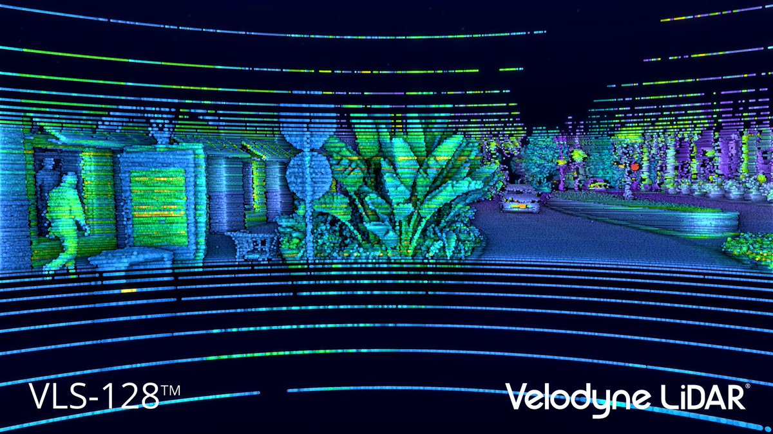
Currently, Lidar used on autonomous vehicles have a detecting range from 100m to 200m, And much higher resolutions to distinguish people from other objects. Because of the development of Lidar industry, we have plenty of resources of point clouds
Sensor
Lidar Scanner
[4] Velodyne Lidar
Source: https://velodynelidar.com/

Slide 6
Principle & Feature of Lidar
Sensor
As currently the most powerful and reliable source of point cloud, many people could ask:
Is that a good idea to use Lidar to sense(understand) the world? Why not use camera, or radar, which are obviously much popular.
So, If your AIM is to have abundant and accurate spatial information.
The answer is yes.
In the next Slide, we can have a brief compare of the difference between data gathered by camera, radar and Lidar.

Slide 7

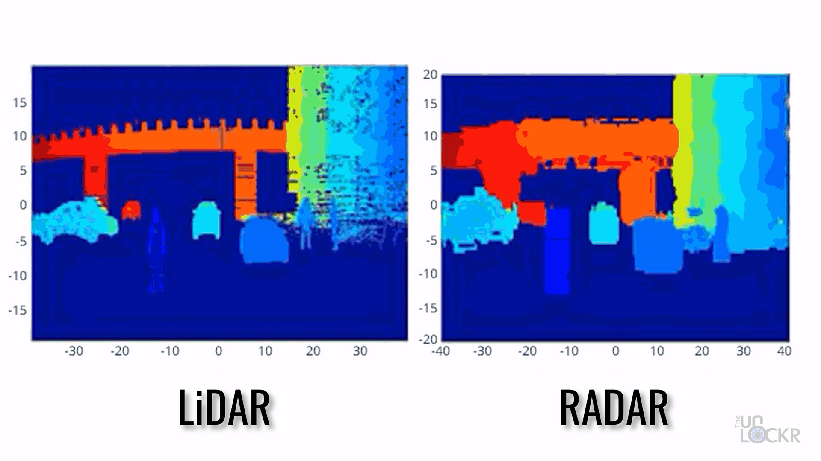
Property of Lidar
Source
Traditionally, we use radar to detect range, and use camera to observe texture.
And Lidar is kind of the middle of radar and camera in function
Here are the advantage of each device
Camera can generate high resolution, rich texture images
Lidar can detect range. As it can emit electromagnetic beam for detection, working in complete darkness is also possible.
It have better resolution than radar, making object classification Possible.
Radar also emit electromagnetic beam to detect object but will get a blur feedback.

Slide 8
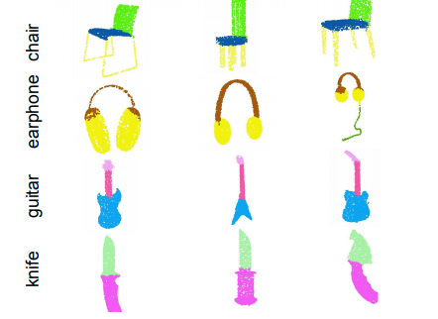
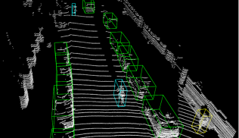
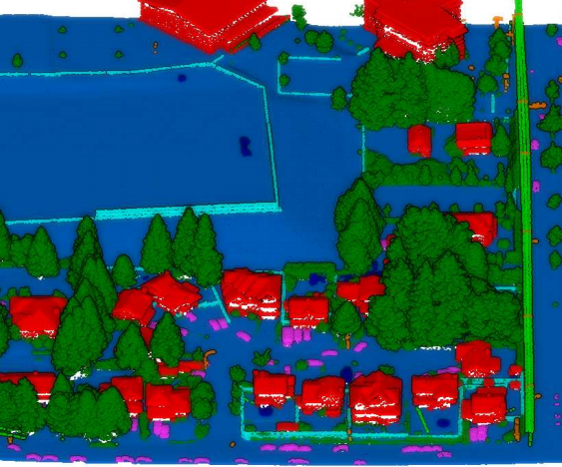
Application
As we have mentioned, point clouds can help Face ID check our identity, help autonomous cars detect and identify people on the road. What else can point clouds do?
Here is the three main area:
Point clouds classification
3D object detection
Point clouds segmentation
Ref: PointNet: deep learning on point sets for 3D classification and segmentation
https://arxiv.org/abs/1612.00593
Ref: VoxelNet: end-to-end learning for point cloud based 3D object detection
https://arxiv.org/abs/1711.06396
Ref: Learning object bounding boxes for 3D instance segmentation on point clouds
https://arxiv.org/abs/1906.01140

Slide 9
How to get started
If you are interested to working on point cloud processing, the following slides are just for you.
First, let me introduce some resources of point cloud data to train you model
ModelNet [6],
ScanObjectNN [7],
ShapeNet [8],
PartNet [9],
S3DIS [10],
ScanNet [11],
Semantic3D [12],
ApolloCar3D[13],
Then, we can dive into a deep learning model for point clouds classification from PointNet

Slide 10
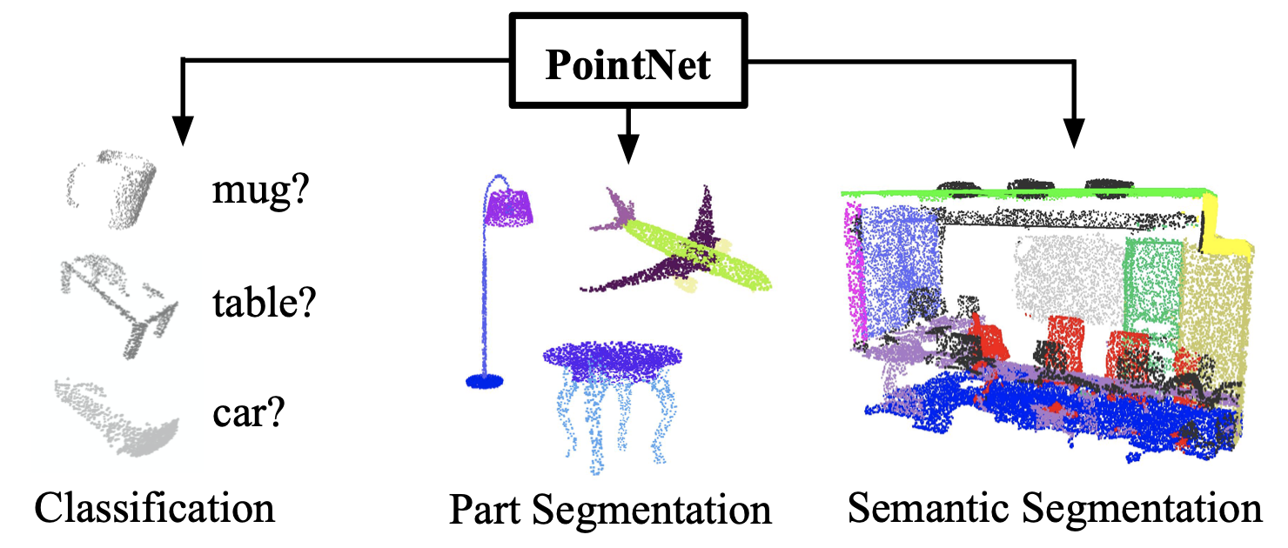
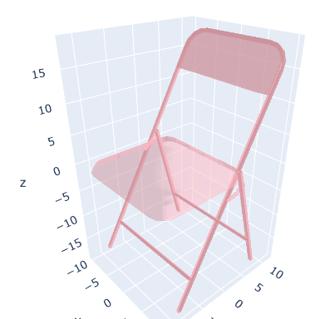
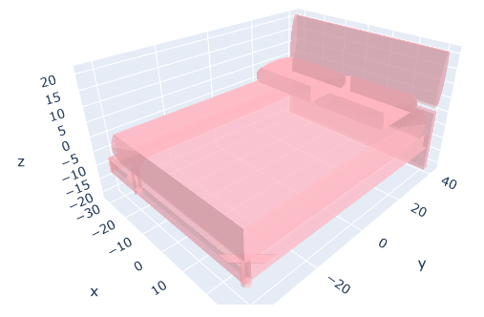
Point cloud Processing: -- Design Principles and Implementation
First, Let us find some training data:
Source: PointNet
Provide data for point cloud classification and segmentation
DataSet: ModelNet10
Data Type: mesh (a collection of vertices and triangular faces that defines the shape)
Class Number: 10 categories;
Content: 3,991 models for training, 908 models for testing;
Other Sources for point cloud:
ModelNet [6], ScanObjectNN [7], ShapeNet [8], PartNet [9], S3DIS [10], ScanNet [11], Semantic3D [12], ApolloCar3D[13]
PointNet application
Meshes in ModelNet10
Ref: PointNet: Deep Learning on Point Sets for 3D Classification and Segmentation
Source: https://arxiv.org/pdf/1612.00593.pdf

Slide 11
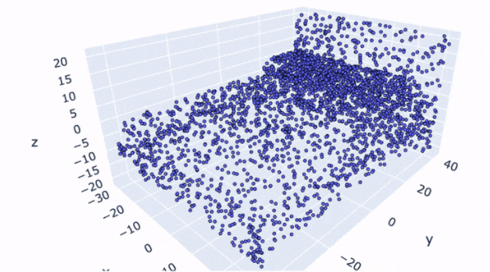
Data preprocessing
## Uniformly sample points
verts, faces = mesh
areas = np.zeros((len(faces)))
verts = np.array(verts)
def triangle_area(pt1, pt2, pt3):
side_a = np.linalg.norm(pt1 - pt2)
side_b = np.linalg.norm(pt2 - pt3)
side_c = np.linalg.norm(pt3 - pt1)
s = 0.5 * ( side_a + side_b + side_c)
return max(s * (s - side_a) * (s - side_b) * (s - side_c), 0)**0.5
for i in range(len(areas)):
areas[i] = (triangle_area(verts[faces[i][0]],
verts[faces[i][1]],
verts[faces[i][2]]))
Data Sampling:
Result:
As points are not uniformly distributed in the raw data, we need:
Uniformly sample points
As the input size of our neural network is fixed, we need
sample a fixed number of points as input from previous distribution.
## sample a fixed number (k) of points
k = 3000
sampled_faces = (random.choices(faces, weights=areas,k=k))
def sample_point(pt1, pt2, pt3):
s, t = sorted([random.random(), random.random()])
f = lambda i: s * pt1[i] + (t-s) * pt2[i] + (1-t) * pt3[i]
return (f(0), f(1), f(2))
pointcloud = np.zeros((k, 3))
for i in range(len(sampled_faces)):
pointcloud[i] = (sample_point(verts[sampled_faces[i][0]],
verts[sampled_faces[i][1]],
verts[sampled_faces[i][2]]))
Ref: visit PointNet for more code
Source: https://github.com/nikitakaraevv/pointnet/blob/master/nbs/PointNetClass.ipynb

Slide 12
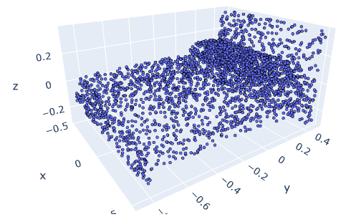
Normalizing by shape:
Data preprocessing
Problem:
Identical objects can have different sizes and can be placed in different parts of coordinate system.
Solution:
1. Translate the object to the origin by subtracting mean from all its points
2. divide some number to make all points lies in range 0~1

Slide 13
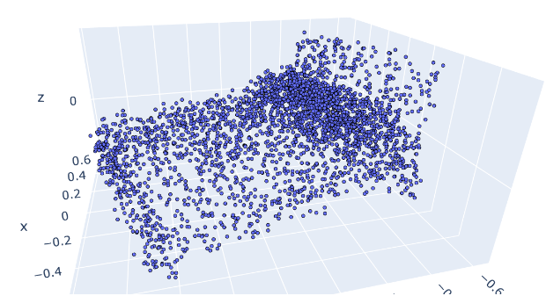
Rotate and add noise:
Data preprocessing
1. randomly rotate objects for some degree for all training data
2. add a random noise (range 0~0.02) to each point
Before adding noise
After adding noise

Slide 14
Model Design:
The model for point cloud classification should have the following properties:
1. Permutation Invariance
2. Transformation Invariance
So, in the next few slides, we will introduce:
1. how to use max pool to generate global feature, which is the signature of a model.
2. how to use T-Net to transform input data, which can achieve Transformation Invariance
3. the final model structure

Slide 15
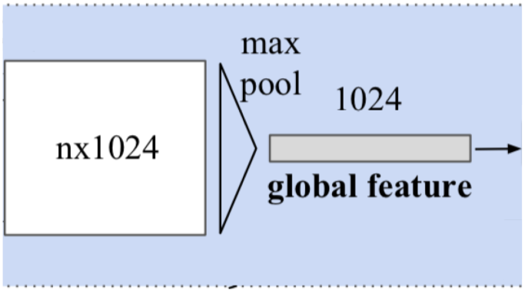
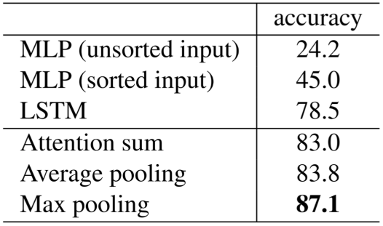
Permutation Invariance
Problem:
As point clouds are inherently unstructured data, the order of point so not say anything,
If we have N data points, there are N! permutations all indicating the exact same object.
Solution:
Use a symmetric function (which will return the same output regardless of the order of the input arguments)
To implement a symmetric functions:
1. we map n points to higher dimension(1024)
2. use max pool to capture the global feature
3. This global feature is used directly for classification
Ref: Empirical testing of symmetric functions (source)

Slide 16
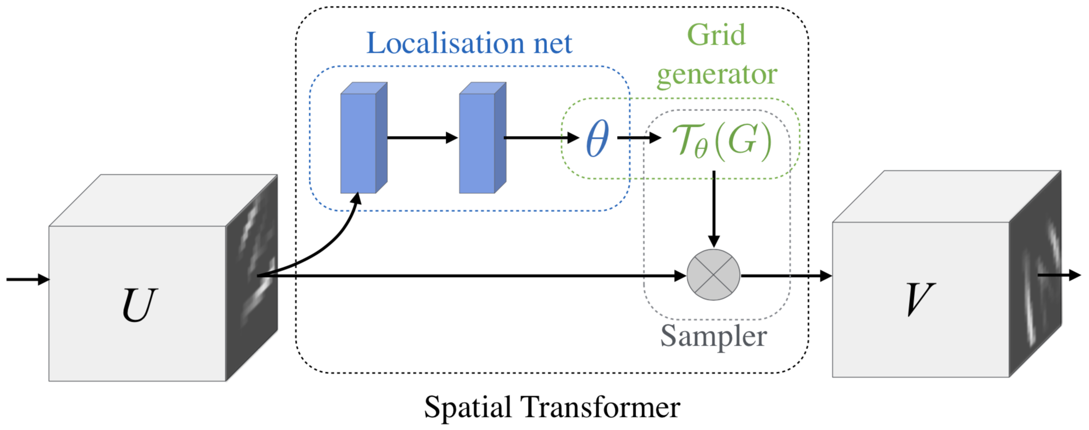
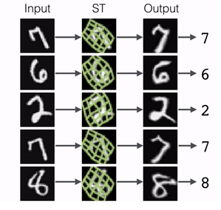
Transformation Invariance
Problem: our models should identify the same object in pose(angle).
Idea: as we already have Spatial Transformer Networks (STN) for 2d object, as shown on the right, can we process 3d points in the same way? Answer is yes.
Principle of STN:
generate a transformation angle θ to normalize the original input U.
Thus as shown on the right picture, input vector of different poses are normalized vertically.
Next: how to use this principle to 3d points
Ref: Review: STN — Spatial Transformer Network (Image Classification)
Source: https://towardsdatascience.com/review-stn-spatial-transformer-network-image-classification-d3cbd98a70aa

Slide 17
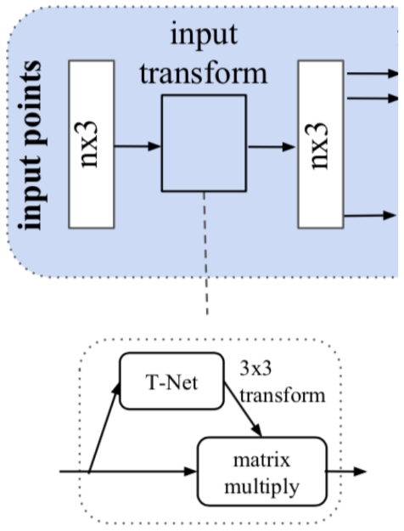
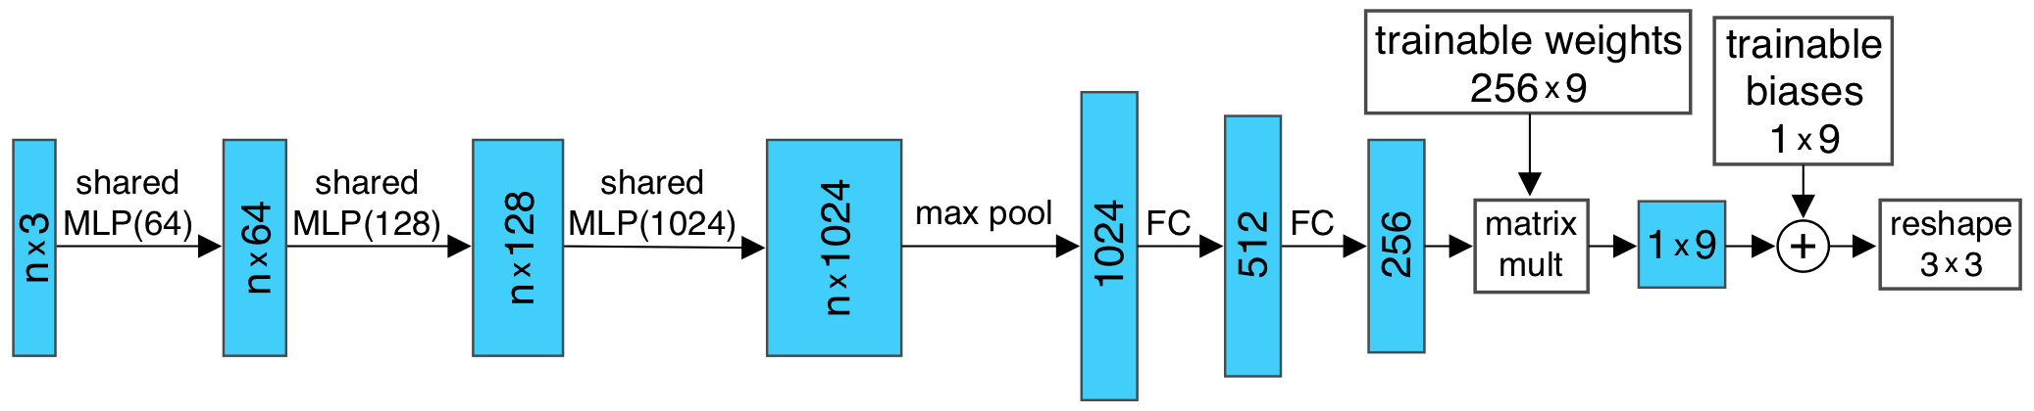
Transformation Invariance
The similar structure of STN is called T-Net
Principle of T-Net:
Based on the whole model, T-Net will generate an transformation matrix of 3*3 shape
Then, it will take each point in this model as input, and output a transformed point, as shown in the right picture
Structure of T-Net are shown below:
Input points(n*3) → encoded global vector(256) → transform matrix(3*3) ; and for the last step, we use some trainable weights to help
Ref: Review: STN — Spatial Transformer Network (Image Classification)

Slide 18
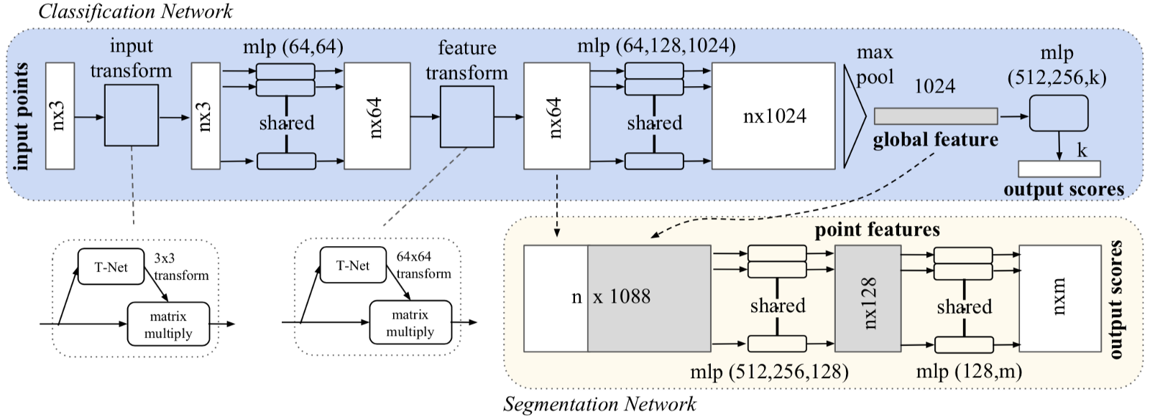
Model structure for: Classification & Segmentation
Ref : https://medium.com/@luis_gonzales/an-in-depth-look-at-pointnet-111d7efdaa1a

Slide 19
Model implementation:
## Layers:
import torch
import torch.nn as nn
import torch.nn.functional as F
class Tnet(nn.Module):
def __init__(self, k=3):
super().__init__()
self.k=k
self.conv1 = nn.Conv1d(k,64,1)
self.conv2 = nn.Conv1d(64,128,1)
self.conv3 = nn.Conv1d(128,1024,1)
self.fc1 = nn.Linear(1024,512)
self.fc2 = nn.Linear(512,256)
self.fc3 = nn.Linear(256,k*k)
self.bn1 = nn.BatchNorm1d(64)
self.bn2 = nn.BatchNorm1d(128)
self.bn3 = nn.BatchNorm1d(1024)
self.bn4 = nn.BatchNorm1d(512)
self.bn5 = nn.BatchNorm1d(256)
def forward(self, input):
# input.shape == (bs,n,3)
bs = input.size(0)
xb = F.relu(self.bn1(self.conv1(input)))
xb = F.relu(self.bn2(self.conv2(xb)))
xb = F.relu(self.bn3(self.conv3(xb)))
pool = nn.MaxPool1d(xb.size(-1))(xb)
flat = nn.Flatten(1)(pool)
xb = F.relu(self.bn4(self.fc1(flat)))
xb = F.relu(self.bn5(self.fc2(xb)))
init = torch.eye(self.k, requires_grad=True).repeat(bs,1,1)
if xb.is_cuda:
init=init.cuda()
# add identity to the output
matrix = self.fc3(xb).view(-1,self.k,self.k) + init
return matrix
Ref : https://medium.com/@luis_gonzales/an-in-depth-look-at-pointnet-111d7efdaa1a

Slide 20
Reference
[1] Point Cloud Conversion to 3D Model; Source: https://www.cadcam.org/3d-scanning/converting-point-clouds-into-cad/
[2] Deep Learning on Point clouds: Implementing PointNet in Google Colab; Source: https://towardsdatascience.com/deep-learning-on-point-clouds-implementing-pointnet-in-google-colab-1fd65cd3a263
[3] Source: https://www.roadtovr.com/apple-iphone-12-pro-max-lidar-instant-ar-depth-mapping/
[4] Velodyne Lidar; Source: https://velodynelidar.com/
[5] PointNet: deep learning on point sets for 3D classification and segmentation; https://arxiv.org/abs/1612.00593
[6] Z. Wu, S. Song, A. Khosla, F. Yu, L. Zhang, X. Tang, and J. Xiao,
“3D shapeNets: A deep representation for volumetric shapes,” in
CVPR, 2015.
[7] M. A. Uy, Q.-H. Pham, B.-S. Hua, T. Nguyen, and S.-K. Yeung,
“Revisiting point cloud classification: A new benchmark dataset
and classification model on real-world data,” in ICCV, 2019.
[8] A. X. Chang, T. Funkhouser, L. Guibas, P. Hanrahan, Q. Huang,
Z. Li, S. Savarese, M. Savva, S. Song, and H. Su, “ShapeNet:
An information-rich 3D model repository,” arXiv preprint
arXiv:1512.03012, 2015.
[9] K. Mo, S. Zhu, A. X. Chang, L. Yi, S. Tripathi, L. J. Guibas, and
H. Su, “PartNet: A large-scale benchmark for fine-grained and
hierarchical part-level 3D object understanding,” in CVPR, 2019.
[10] I. Armeni, O. Sener, A. R. Zamir, H. Jiang, I. Brilakis, M. Fischer,
and S. Savarese, “3D semantic parsing of large-scale indoor
spaces,” in CVPR, 2016.
[11] A. Dai, A. X. Chang, M. Savva, M. Halber, T. Funkhouser, and
M. Nießner, “ScanNet: Richly-annotated 3D reconstructions of
indoor scenes,” in CVPR, 2017.
[12] T. Hackel, N. Savinov, L. Ladicky, J. Wegner, K. Schindler, and
M. Pollefeys, “Semantic3D.net: A new large-scale point cloud
classification benchmark,” ISPRS, 2017.
[13] X. Song, P. Wang, D. Zhou, R. Zhu, C. Guan, Y. Dai, H. Su,
H. Li, and R. Yang, “Apollocar3D: A large 3D car instance
understanding benchmark for autonomous driving,” in CVPR,
2019.

